Slide 2
Module 7: Advanced SQL Day 3

Slide 3
Agenda XX.XX.2022
from | to | topic
9:00 | 9:15 | Introduction
9:15 | 12:30 | Self Study Block
~10:30 | ~10:45 | Coffee break
12:00 | 12:30 | Discussion Block: Self Study Session
12:30 | ~13:00 | Lunch Break
13:00 | 13:30 | Content Questions
13:30 | 16:00 | Excecise Block
16:00 | 17:00 | Discussion Block : Excercise

Slide 4
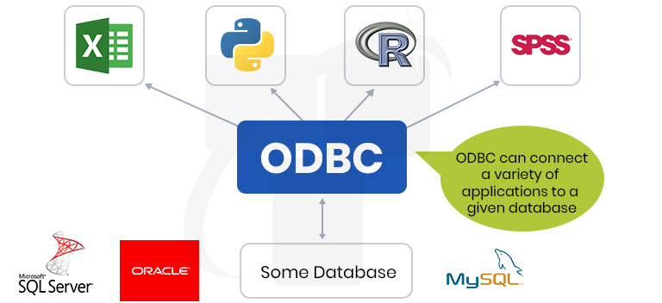
Topics for today in Breif
ODBC
Open Database Connectivity (ODBC) is an open standard Application Programming Interface (API) for accessing a database. By using ODBC statements in a program, you can access files in a number of different common databases.

Slide 5
Material
Watch the below videos:
https://www.youtube.com/watch?v=NJ3_apdjFZY&list=PLUDwpEzHYYLt0aRs7gvyEEviMp_CoTO3q&index=14
https://www.youtube.com/watch?v=mpAUobL7DLA&list=PLUDwpEzHYYLt0aRs7gvyEEviMp_CoTO3q&index=15
Go through the below training material:
https://learning.oreilly.com/library/view/sql-for-dummies/9781119527077/c17.xhtml
Go though the ‘ODBC advanced‘ section of below link:
https://learn.microsoft.com/en-us/sql/odbc/microsoft-open-database-connectivity-odbc?view=sql-server-ver16

Slide 6
Exercise
Practice JOINS exercise from the below links.
https://www.w3resource.com/sql-exercises/soccer-database-exercise/joins-exercises-on-soccer-database.php
https://www.w3resource.com/sql-exercises/movie-database-exercise/joins-exercises-on-movie-database.php

Slide 7
Good luck!
Dein yakha Team

